Slide 1
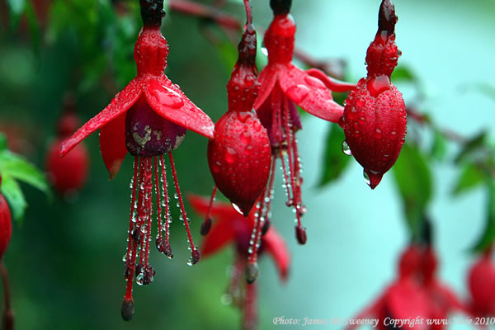
Gal 5:22: But the fruit of the Spirit is love, joy, peace, patience, kindness, goodness, faithfulness, gentleness and self- control.

Slide 2
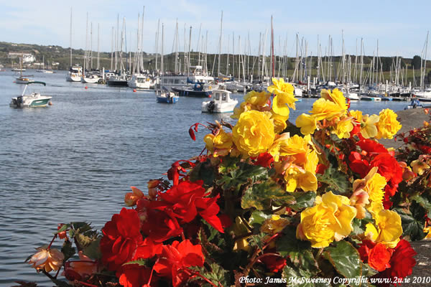
Gal 2:20: I have been crucified with Christ and I no longer live, but Christ lives in me. I live by faith in the Son of God, who loved me and gave himself for me.

Slide 3
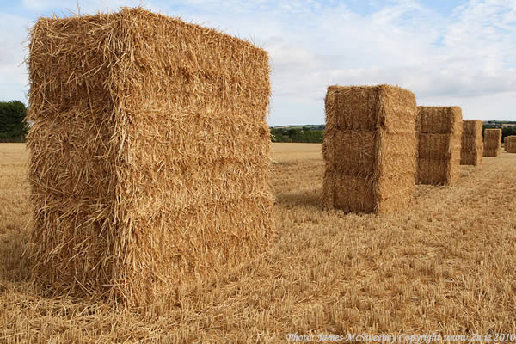
John 10:10: The thief comes only to steal and kill and destroy;
I have come that they may have life, and have it to the full.

Slide 4
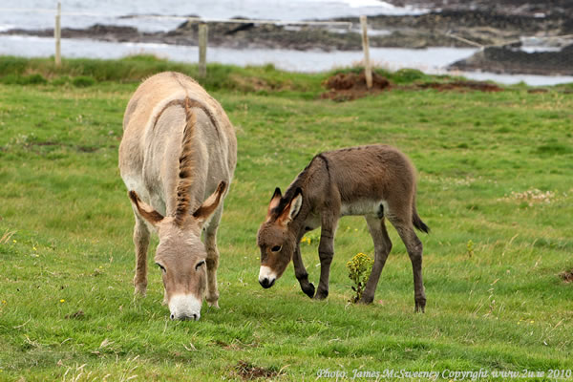
Eph 2:10: We are God’s workmanship

Slide 5
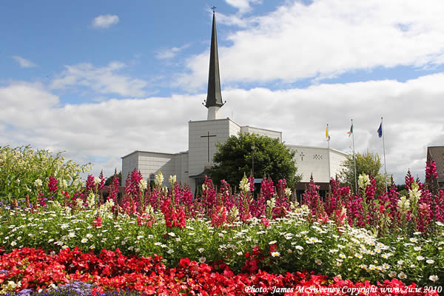
2 Cor 5:17: If anyone is in Christ, she is a new creation; the old has gone, the new has come!

Slide 6
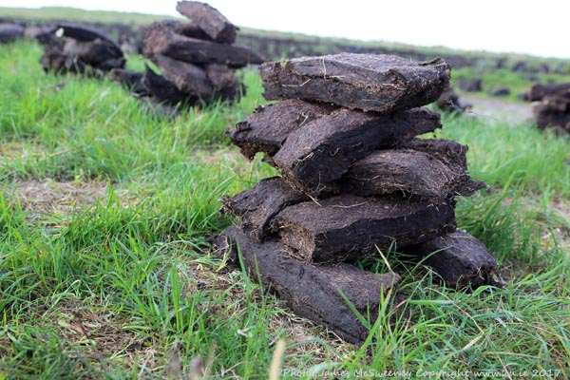
John 14:6: Jesus said,
“I am the way and the truth and the life.”

Slide 7
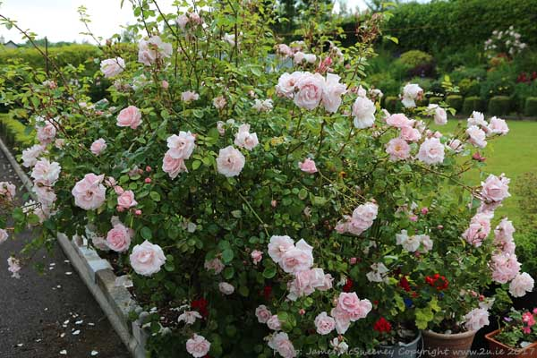
Isa 40:31: Those who hope in the Lord will renew their strength. They will soar on wings like eagles; they will run and not grow weary, they will walk and not be faint.

Slide 8
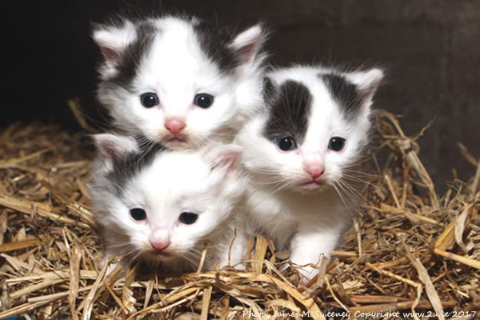
2 Cor 12:9: He said to me, “My grace is sufficient
for you.”

Slide 9
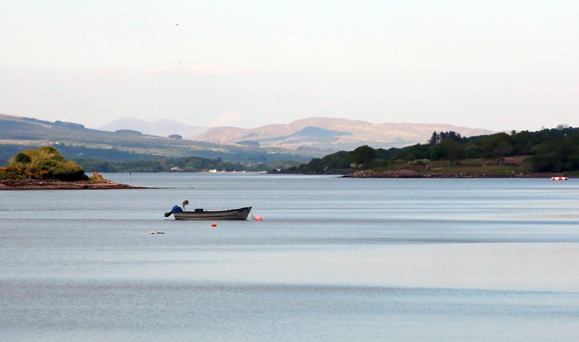
2 Tim 1:7: For God did not give us a spirit of timidity, but a spirit of power, of love and of self-discipline.

Slide 10
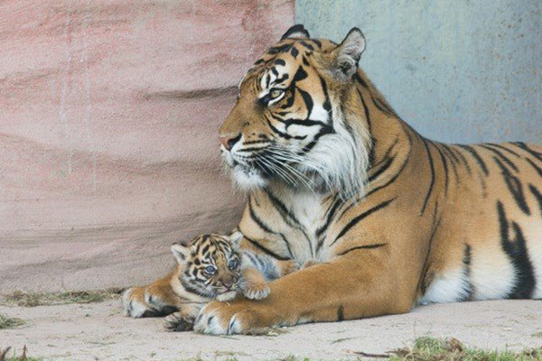
Phil 4:13: I can do everything through him who gives me strength.

Slide 11
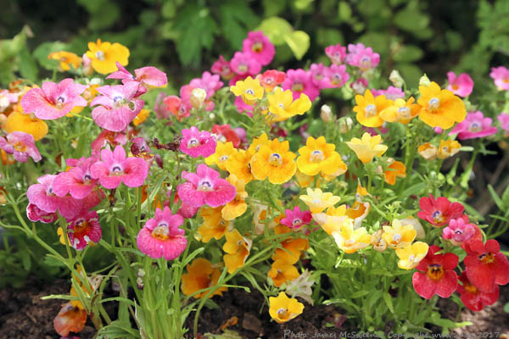
Phil 4:8: Whatever is true, whatever is noble, whatever is right, whatever is pure, whatever is lovely, whatever is admirable - if anything is excellent or praiseworthy - think about such things.

Slide 12
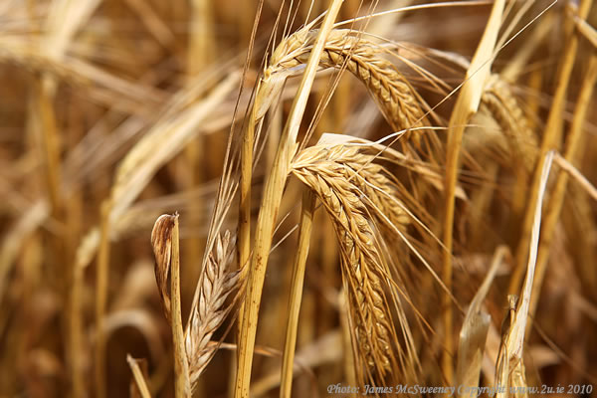
Josh 1:9: Have I not told you? Be strong and courageous. Do not be terrified; do not be discouraged, for the Lord your God will be with you wherever you go.

Slide 13
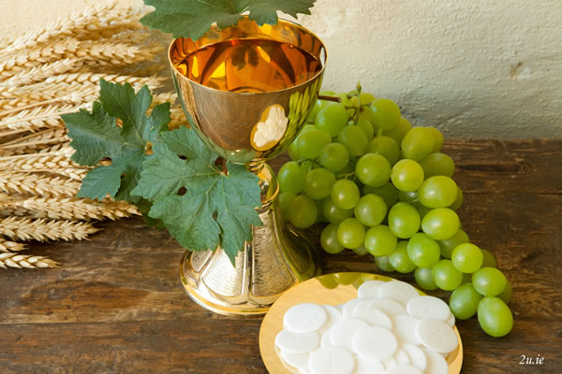
Matt 28:20: I am with you always, to the very end of the age.

Slide 14
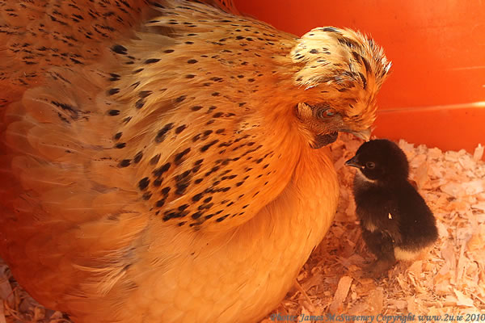
John 14:27: Peace I leave with you; my peace I give you. I do not give to you as the world gives. Do not let your hearts be troubled and do not be afraid.

