Slide 1
1 Pet 5:7: Cast all your anxiety on him because he cares for you.

Slide 2
Isa 41:10:
Do not fear, for I am with you; do not be dismayed, for I am your God. I will strengthen you and help you; I will uphold you with my righteous right hand.

Slide 3
1 Cor 10:13: God is faithful; he will not let you be tempted beyond what you can bear. When you are tempted, he will also provide a way out so that you can stand up under it.

Slide 4
Heb 12:2:
Let us fix our eyes on Jesus, the author and perfecter of our faith, who for the joy set before him endured the cross and sat down at the right hand of the throne of God.

Slide 5
Heb 11:1:
Now faith is being sure of what we hope for and certain of what we do not see.

Slide 6
Eph 3:20:
God is able to do immeasurably more than we can ask or imagine…

Slide 7
Rom 10:9:
If you confess with your lips that Jesus is Lord, and believe in your heart that God raised him from the dead, you will be saved.

Slide 8
John 1:1: In the beginning was the Word, and the Word was with God, and the Word was God.

Slide 9
John 16:33: I have told you these things, so that in me you may have peace. In this world you will have trouble, but take heart! I have overcome the world.

Slide 10
Phil 4:19: My God will meet all your needs according to his glorious riches.

Slide 11
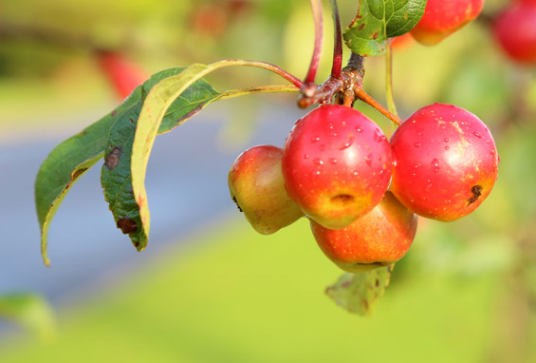
Ps 37:4: Delight yourself in the Lord and he will give you the desires of your heart.

Slide 12
Phil 4:6: Do not be anxious about anything, but in everything, by prayer and petition, with thanksgiving, present your requests to God.

Slide 13
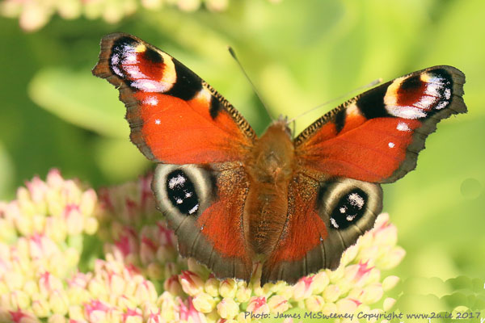
Isa 55:8: “For my thoughts are not your thoughts, neither are your ways my ways,” declares the Lord.

Slide 14
Eph 2:8: It is by grace you have been saved, through faith - this not from yourselves, it is the gift of God.

