Slide 1
Key Stage 2

Slide 2
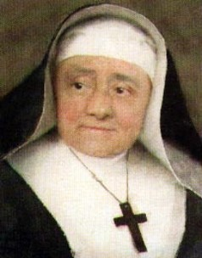
Sisters of St. Paul the Apostle

Slide 3
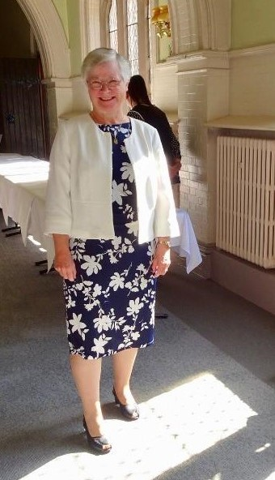
My name is Patricia
I am a Sister of St. Paul

Slide 4
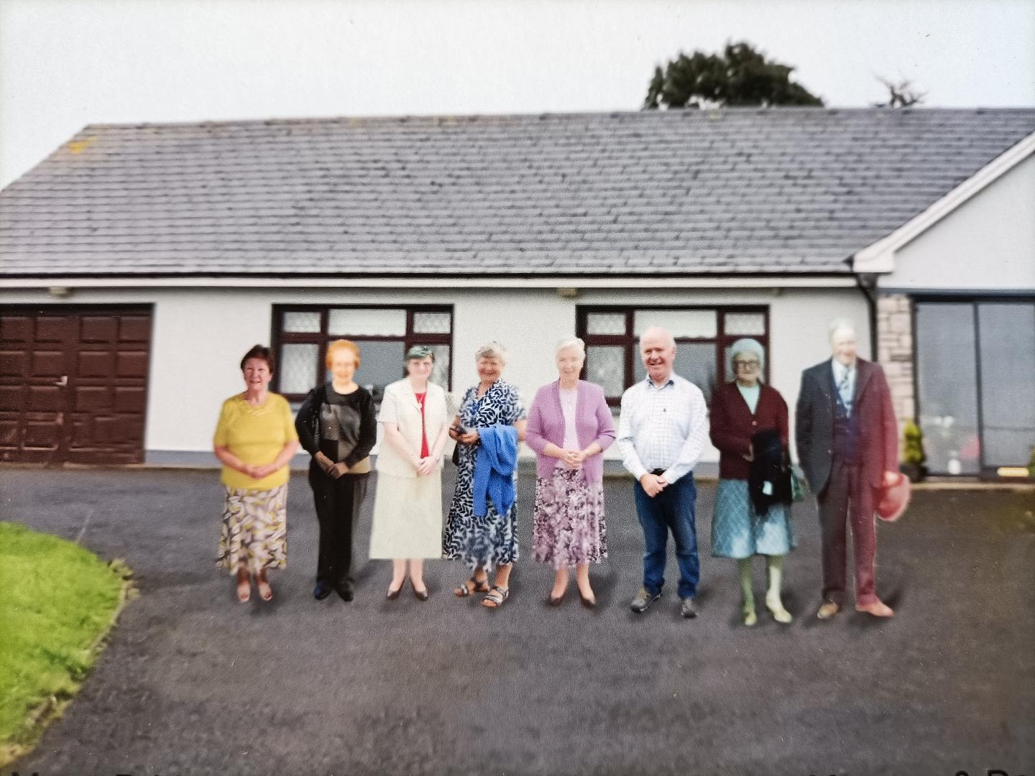
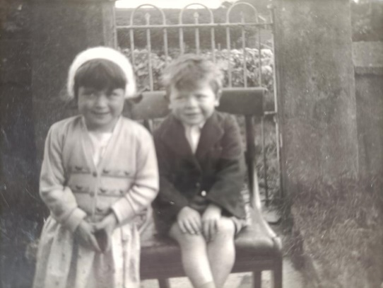
My Family
I have four sisters and one brother

Slide 5
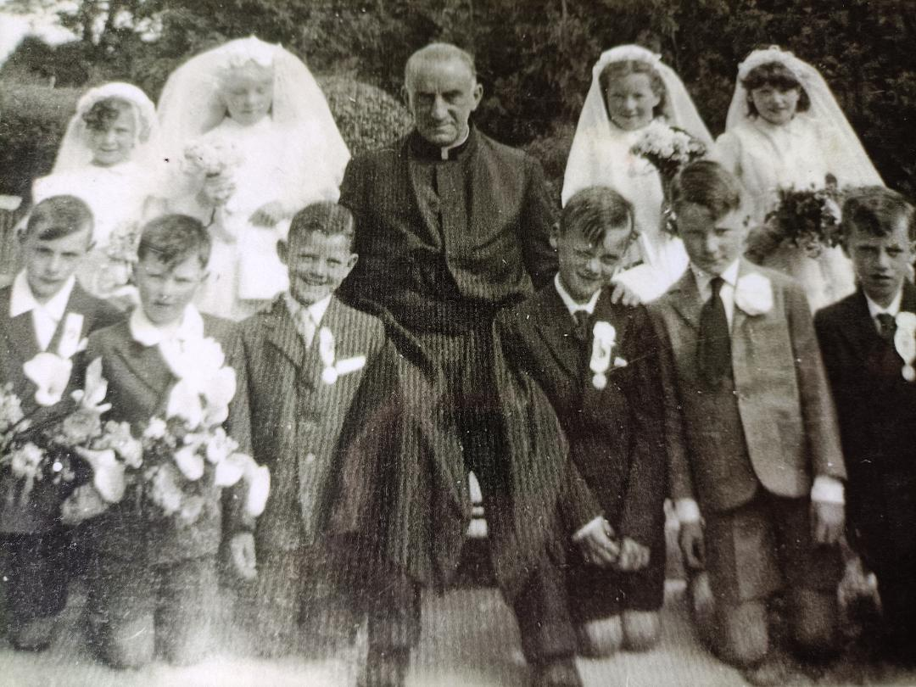
I made my
First Holy Communion when I was 7 years old

Slide 6
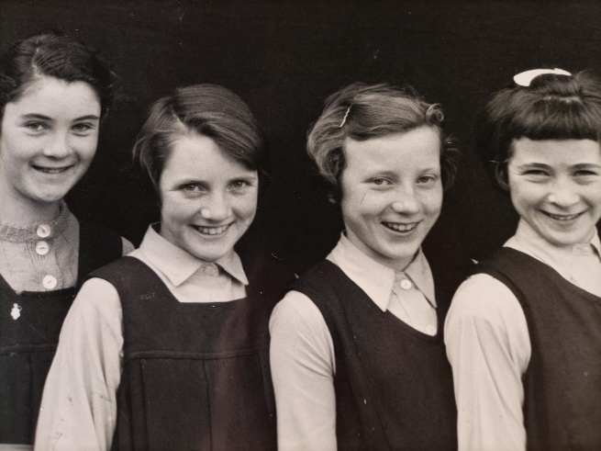
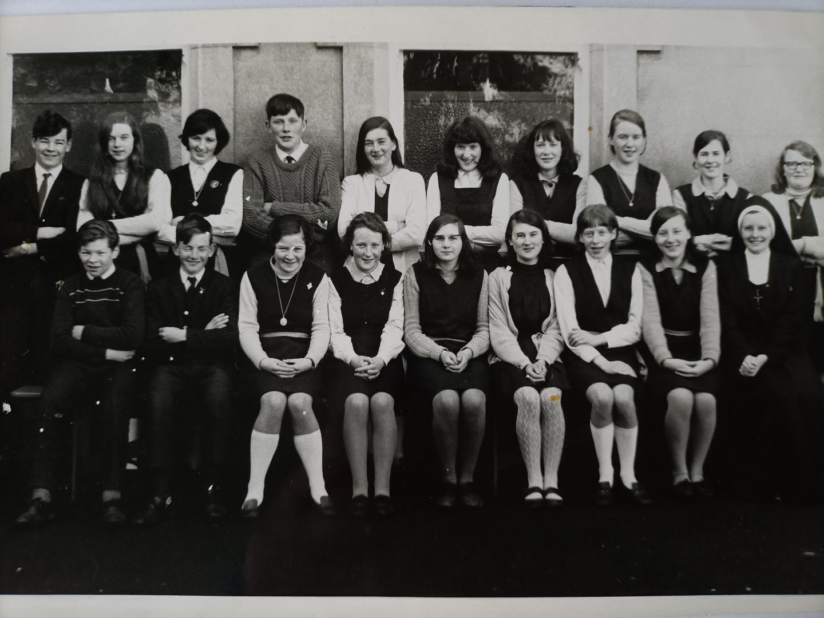
Senior School
What Now

Slide 7
What was God calling me to be?
What was God calling me to do?

Slide 8
What is a Vocation
Everyone has a vocation and discovering our vocation is a part of our journey of faith.
There are three distinctive parts to our vocation :
The Call to Holiness.
The Call to a Way of Life
The Call to Work

Slide 9
How does God call us?
God calls us and reveals himself to us in
a number of ways through:
the Sacraments
Scripture
liturgy and prayer
the actions of others.
In Baptism, we begin our Vocation journey. It is strengthened by the sacraments of Reconciliation and the Eucharist and further developed in Confirmation.

Slide 10
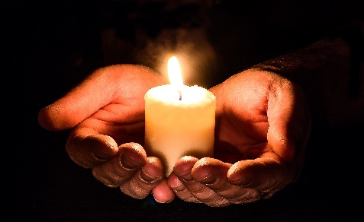
Prayer
Our personal relationship with God forms the foundation of our vocation journey. Prayer is as much about listening as it is about asking, praising, saying sorry and giving thanks. It is important that we have the self-discipline to allow there to be time and space in our lives for prayer.

Slide 11
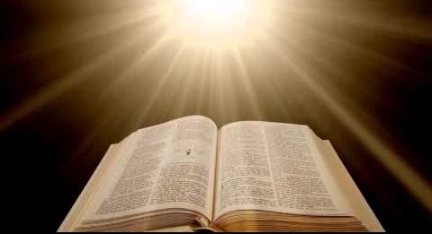
Scripture
The holy Scriptures gives us many examples of those people of God who listened to his call. In the Gospels, we encounter the person of Jesus Christ who, as the Son of God, provides that perfect model through both his words and actions of how we are to be holy.

Slide 12
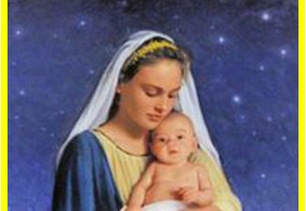
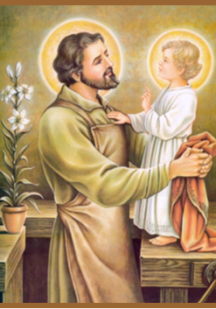
The Saints
The lives of the saints’ model for us a variety of ways in which God’s call was heard and answered. Our school saints have made powerful comments about their vocation.
Mary Mother of Jesus-
“I am the Lord’s servant.
May this happen to me as you have said.”
St Joseph Husband of Mary-
St Joseph faithfully fulfilled his high trust of protecting and guarding God's greatest treasures upon earth, Jesus, and Mary.

Slide 13
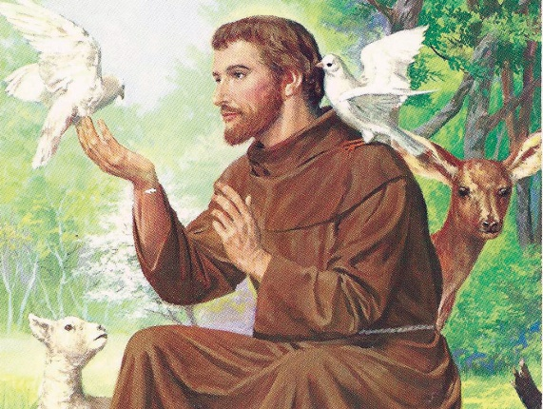
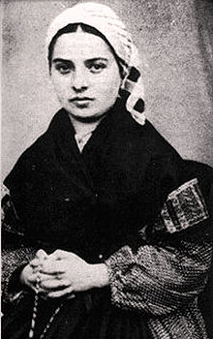
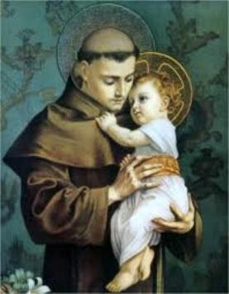
St Francis of Assisi-
“This is what I want, this is what I desire with all my heart.”
St Bernadette-
“I have prayed much to know if I’m called to religious life. I believe the answer is yes. I would like to enter the congregation if I am accepted. “
St Anthony of Padua-
“I would gladly put on the habit of your order if you would promise to send me as soon as possible to the land of the Saracens, that I may gain the crown of the Holy Martyrs.”

Slide 14
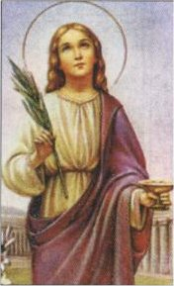
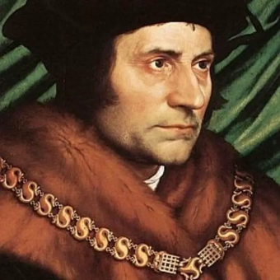
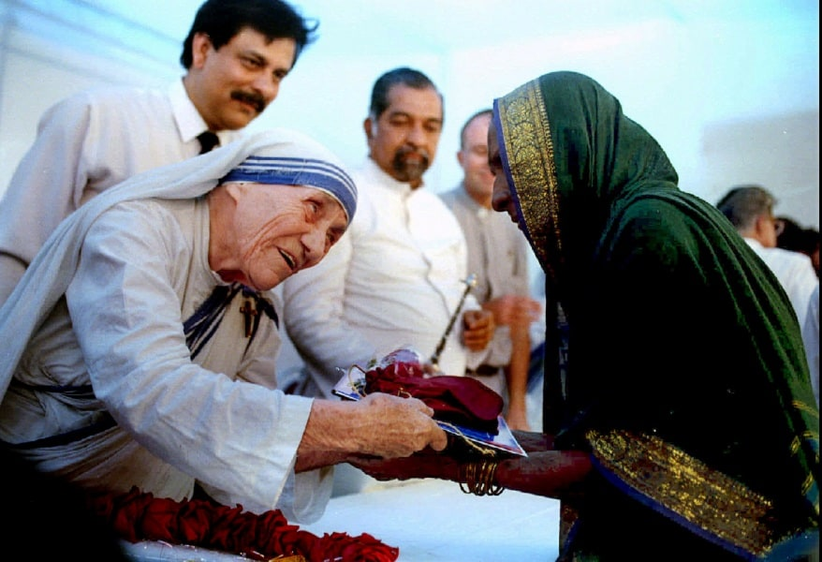
St Lucy-
When she was young, she made a vow to God, that she would stay a virgin and only serve him.
St Thomas More-
“I am the King’s good servant but God’s first.”
St Teresa of Calcutta-
“By blood I am Albanian. By citizenship, Indian. By faith, I am a Catholic nun. As to my calling, I belong to the world. As to my heart, I belong entirely to the heart of Jesus.“

Slide 15
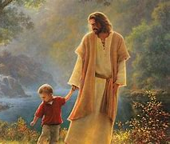
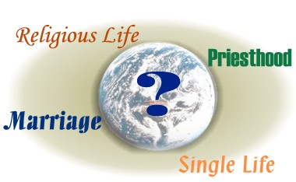
The Call to a Way of Life
This aspect of vocation refers to the choices we make about how we want to live our lives. It is about becoming the person that God is calling us to be and how, as a member of the Church, we are going to serve God and serve others. When we come to make choices about our way of life it has to be done so within our relationship with God.
This aspect of vocation refers to the choices we make about how we want to live our lives. It is about becoming the person that God is calling us to be and how, as a member of the Church, we are going to serve God and serve others. When we come to make choices about our way of life it has to be done so within our relationship with God.

Slide 16
The Call to a Way of Life
There are four states of life which
people are called to:
Marriage
Single Life
Priesthood
Religious Life
Marriage and Holy Orders are recognised as Sacraments of Mission
because people choose, through discernment,
to follow these particular ways of life.
Religious life and the single life, although they are not Sacramental
are an important part of the Church.

Slide 17
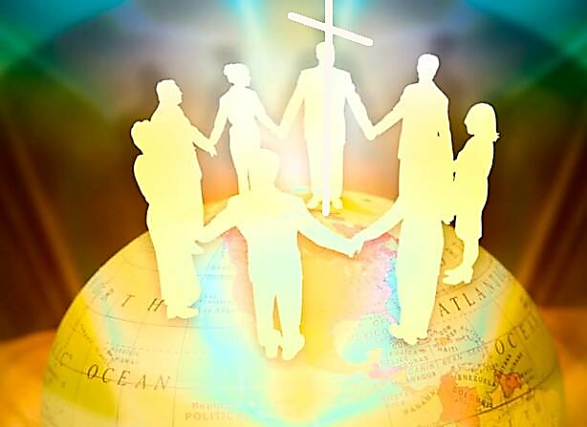
The Call to Work
God calls people to many different kinds of work, ranging from paid work, to care of family members. Work on its own does not give meaning to life however; it is human beings who make work meaningful. ‘Work constitutes one of the fundamental dimensions of a person’s earthly existence and of their vocation.’

Slide 18
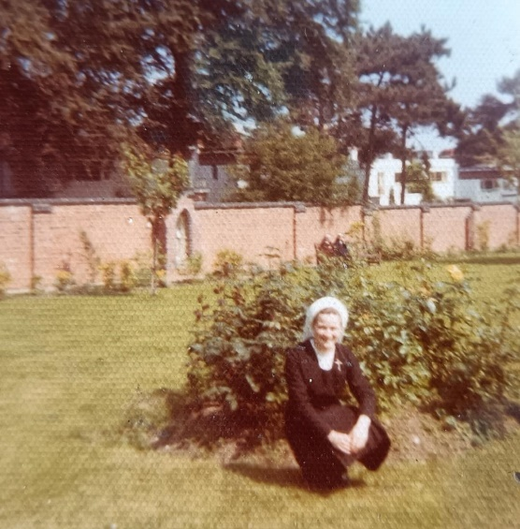
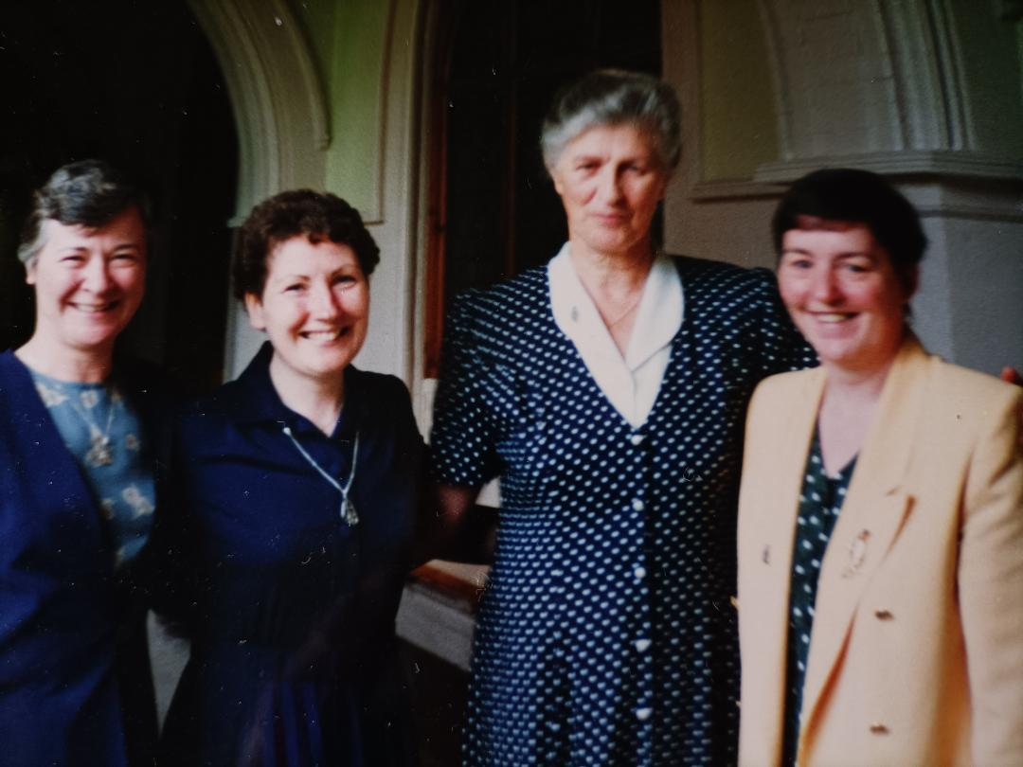
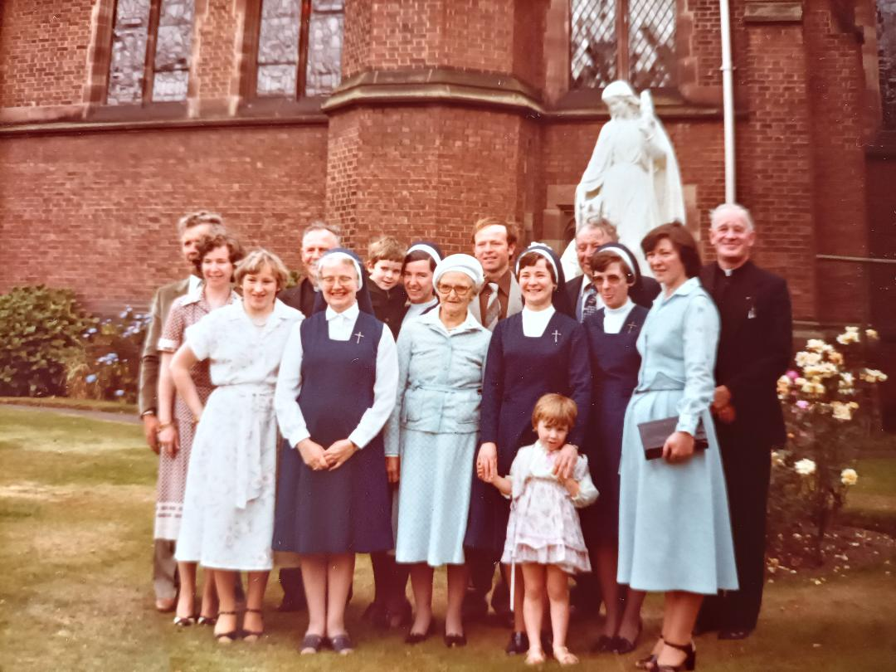
I chose to follow God’s call
to be a Sister of St. Paul.

Slide 19
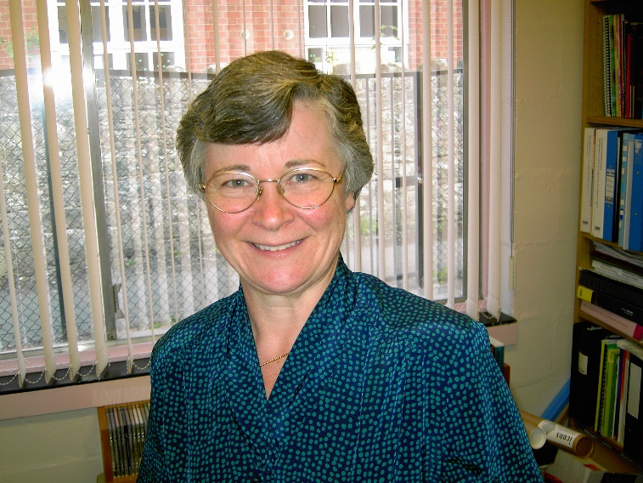
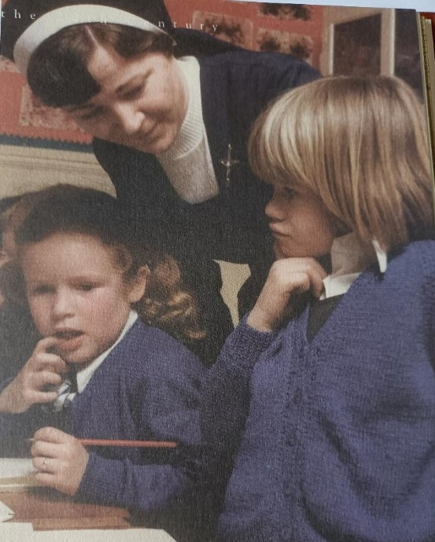
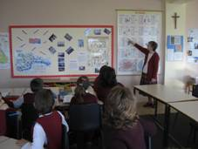
As a Sister I
trained to be
a teacher

Slide 20
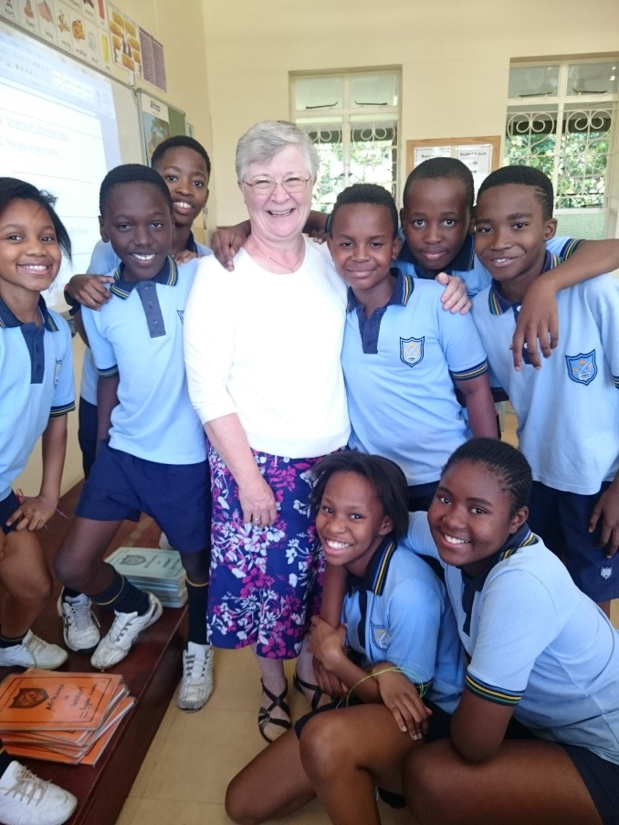
Teaching in South Africa

Slide 21
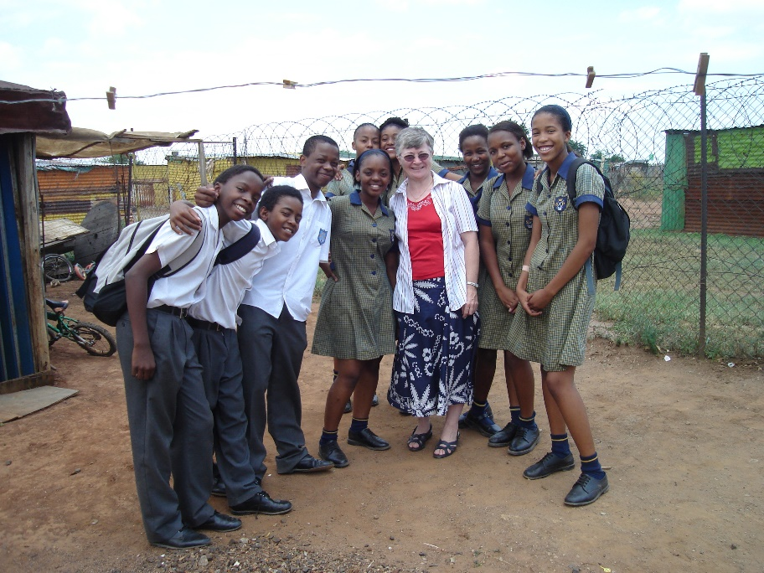
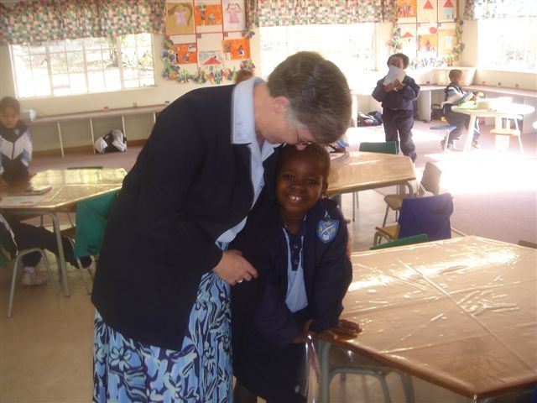
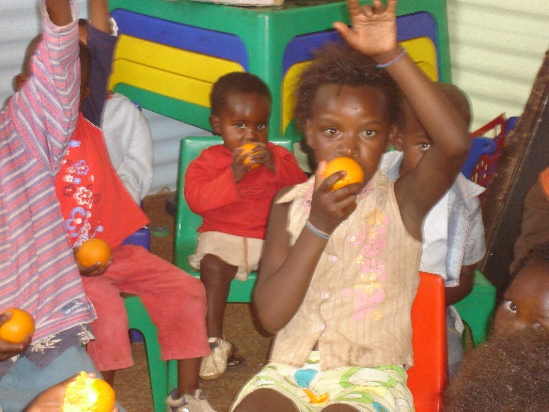
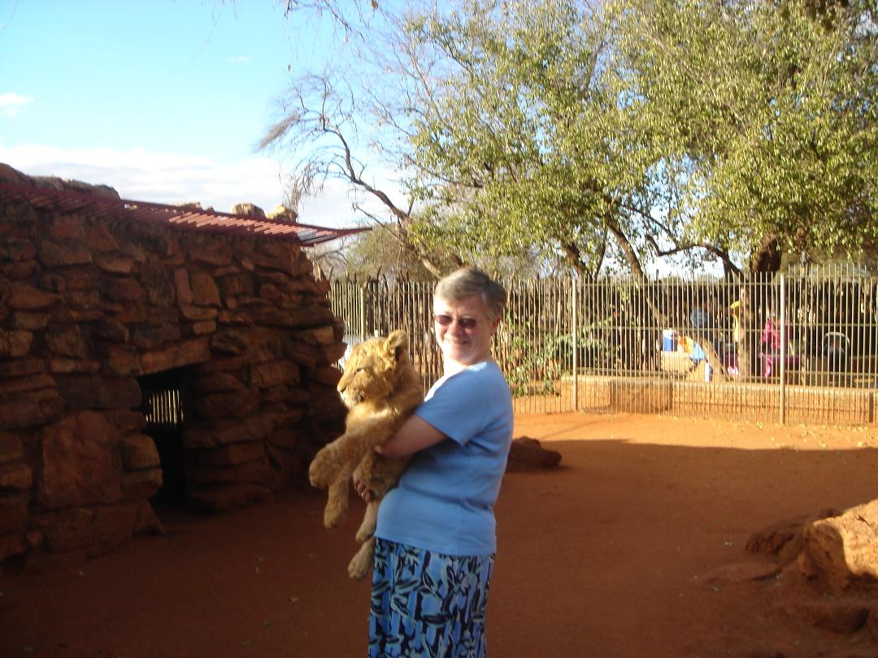
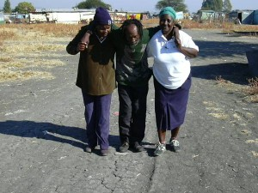
Life in
South Africa

Slide 22
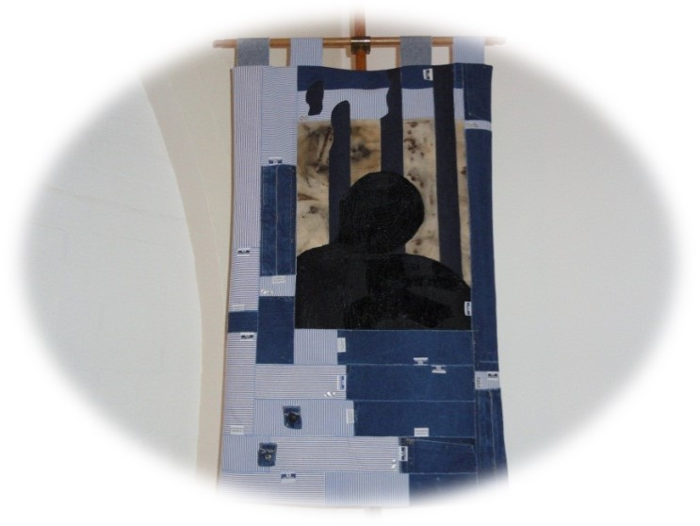
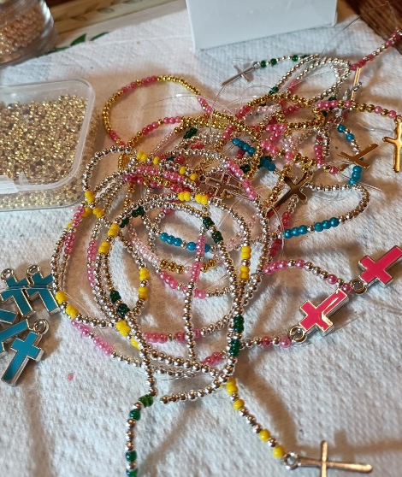
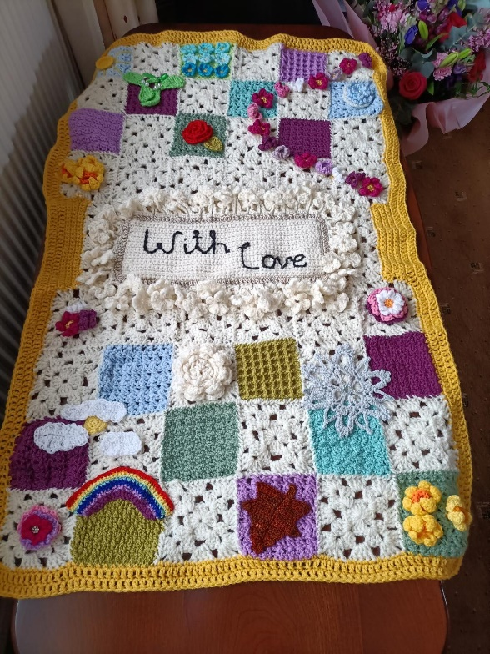
I’ve had the privilege
to work as a Chaplain
in a Women’s Prison
for the last 14years.

Slide 23
Mother Genevieve
died in 1903
at the age of 91.
The work she began
still continues.
We need more generous women
to join us in our work.

Slide 24
Vocation Prayer
Father, you created me and put me on earth for a purpose.
Jesus, you died for me and called me to complete your work.
Holy Spirit, you help me to carry out the work
for which I have been created and called.
In your presence and name, Father, Son and Holy Spirit
I offer this day to you.
May all my thoughts, actions and words have their origin in you
and be directed to your glory. Amen.

